Slide 1
The 20 Most Powerful
Questions to Transform
Your Donor Relationships
Nov 18, 2021

Slide 2
What you will Learn
How & Why Questions Deepen Relationships
Stages of Donor Relationship
20 Powerful Questions to Ask Your Donors and What They Reveal

Slide 3
What makes asking questions a powerful way to deepen our relationships?

Slide 4
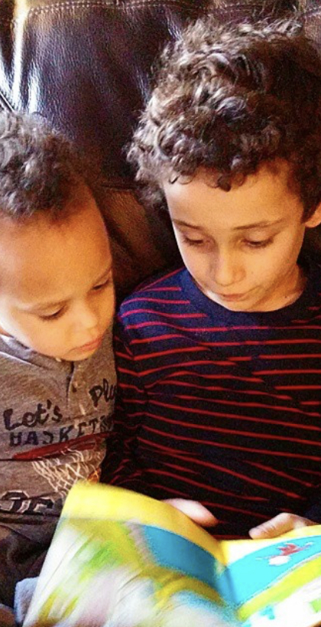
Curiosity
Leads to discovery and learning of others.
Creates Conditions for Understanding.
Allows others to feel “known”

Slide 5
Relationship Building Process
Curiosity
Authentic
Connection
Understanding
Trust

Slide 6
For What Purpose?
Learn what is important to the donor (what they value) and matched it to the organizational needs.
Values are what motivate giving!

Slide 7
“Values are like fingerprints. Nobody’s is the same, but you leave them all over everything you do.” –Elivs Presley

Slide 8
Stages of Donor Relationship
Identify
Qualify
Cultivate
Solicit
Stewardship
Interest
Do they want to get to know me?
Getting to know each other
Give and Take
Appreciation

Slide 9
Questions Do’s & Don’ts
Open Ended | Closed Yes/No
How | Why
Ask | Make Assumptions
Listen | Talk too much
Plan | Wing it
Open State | Reactionary
Ask Permission | No choice
Honest | Withhold information
Make mistakes | Be perfect

Slide 10
The 20 Most Powerful
Questions to Transform
Your Donor Relationships

Slide 11
The 20 Most Powerful Questions
1. What are we doing that you get most excited about?
2. What makes you so passion about that?
3. At what point did giving/ donating become important to you?
4. What makes our charity so important to you?
5. When did you first hear about our organization and prompted you to make the first gift?

Slide 12
The 20 Most Powerful Questions
6. What is your preference in how I communicate with you?
7. How would you best like updates on the impact of your giving?
8. When you give to us what is your hope and expectation of that gift?
9. Besides your giving would you like to be involved with us in other ways? How?
10. What brings you joy?

Slide 13
The 20 Most Powerful Questions
11. How do you make decisions about your giving?
12.What is the best experience you had making a gift?
13. How do you involve your kids/family in giving?
14. What would get you so excited that you would want to make a significant investment in our organization?
15. What would you need to know
to take the next step?

Slide 14
The 20 Most Powerful Questions
16. How have you felt about the relationship with the organization? Would there be anything you would change?
17. What are some of your hopes for our world right now? How do you feel our mission gives you hope? If so, how?
18. What do you feel are the most important issues for society to be resolving right now?
19. What’s holding you back from making a change?
20. If we were completely successful, what
would that do for you?

Slide 15
Evolve your Relationships
Be open
Have a plan/purpose
Be curious
Listen
Ask
Learn
Use what you learn

Slide 16
ericajoywest.com
ericajoywest@gmail.com
LinkedIn: linkedin.com/in/erica-joy-west/
Contact

